Slide 1
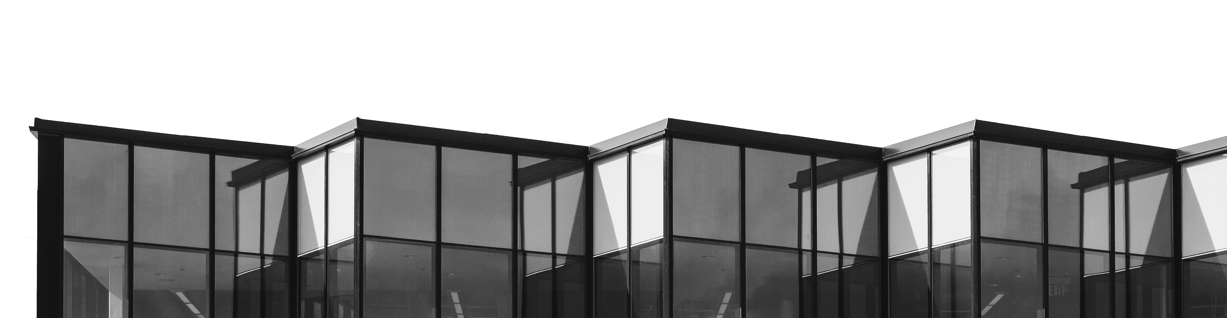
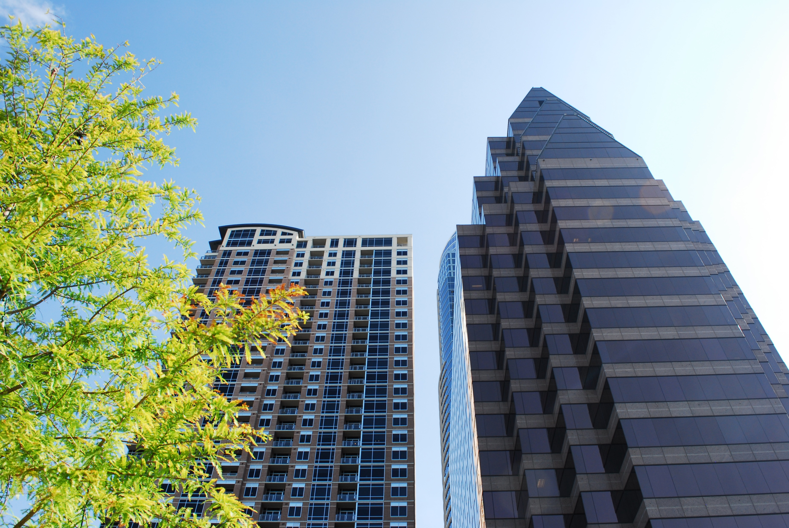
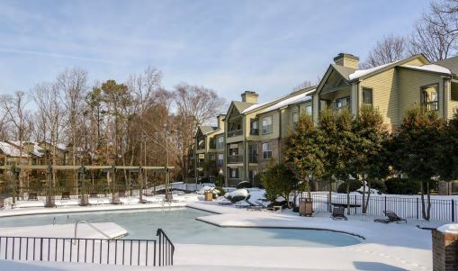

Property Description
Property Type: XXXXX
Sale Price: $XXXXXXX
Property address:
XXXX S Lamar
Austin, TX 78731
Overview
Sale Price (USD): $XXXXXXXX
Land Area (acres): 0.00
Building Area (Square Feet): 0,000 SF
Number of stories: 1
Cap Rate (%): X.XX%
NOI (USD): $XXX,XXX
Zoning:
Year Built: XXXXX
Traffic Count: XXXXXXX
Name
Company
Address
City, State
Phone
Email
Property Description:
xxxxxxxxxxxxxxxxxxxxxxxxxxxxxxxxxxxxxxxxxxxxxxxx

